Slide 1

Overview
The project involves analysing university rankings from different systems, assessing the impact of ranking criteria on university positions, and analysing changes in university metrics over time. This analysis has been done using SQL and Excel for data aggregation and exploratory data analysis (EDA). Additionally, a Power BI dashboard has been created to provide a comprehensive view of university rankings. The project involves the following:
Comparing university rankings across different ranking systems.
Assessing the impact of ranking criteria on university positions.
Analysing changes in university metrics (such as student-to-staff ratio) over time.
Aggregating and transforming data using SQL and Excel for analysis.
Conducting exploratory data analysis (EDA) to gain insights from the dataset.
Creating a Power BI dashboard to visualize and present the findings in a comprehensive manner.
The analysis of this dataset provides valuable insights into how different ranking systems evaluate universities, the factors influencing their rankings, and how universities' metrics change over time. This project aims to offer a deeper understanding of university rankings, helping stakeholders in academia, policy, and make informed decisions and assess the performance of universities over time.

Slide 2
Is there a correlation between number of universities and a country's GDP?
In our existing dataset, we unfortunately lack information about a country's GDP, preventing us from drawing any direct conclusions regarding the relationship between a nation's economic performance and the number of universities. In order to conduct a more comprehensive analysis, it is imperative to integrate GDP data into our dataset, which will enable us to perform further examinations

Slide 3
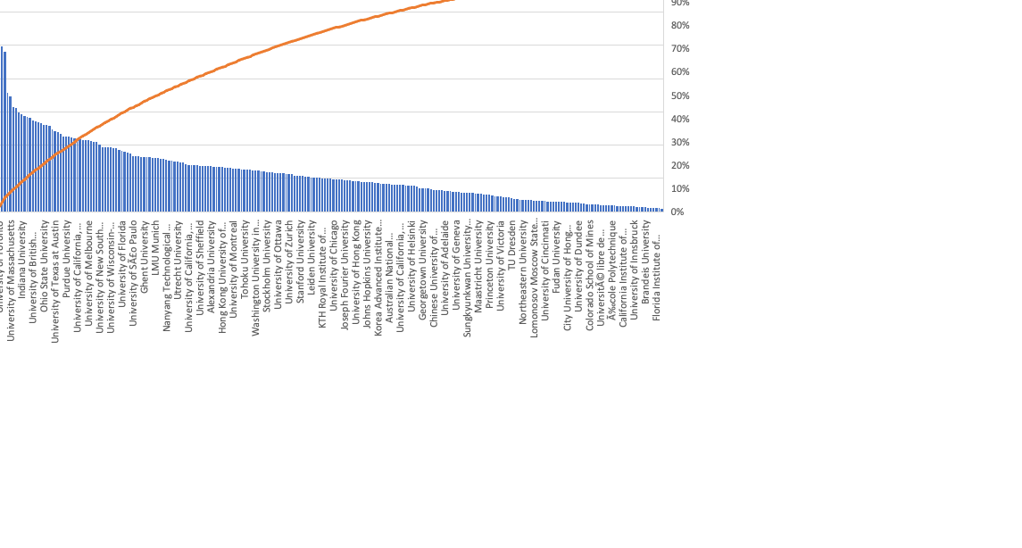
How does the number of male students differ across universities?

Slide 4
How has the number of universities changed over the years in each country?

Slide 5
Is there a relationship between number of universities and a country’s population?
Unfortunately, our existing dataset lacks information about the population of each country, which limits our capacity to draw immediate conclusions about the relationship between a country's population and the number of universities. To conduct a more comprehensive analysis, it's crucial to integrate population data into our dataset, enabling us to carry out more extensive research on this matter.

Slide 6
What is student staff ratio across universities?

Slide 7
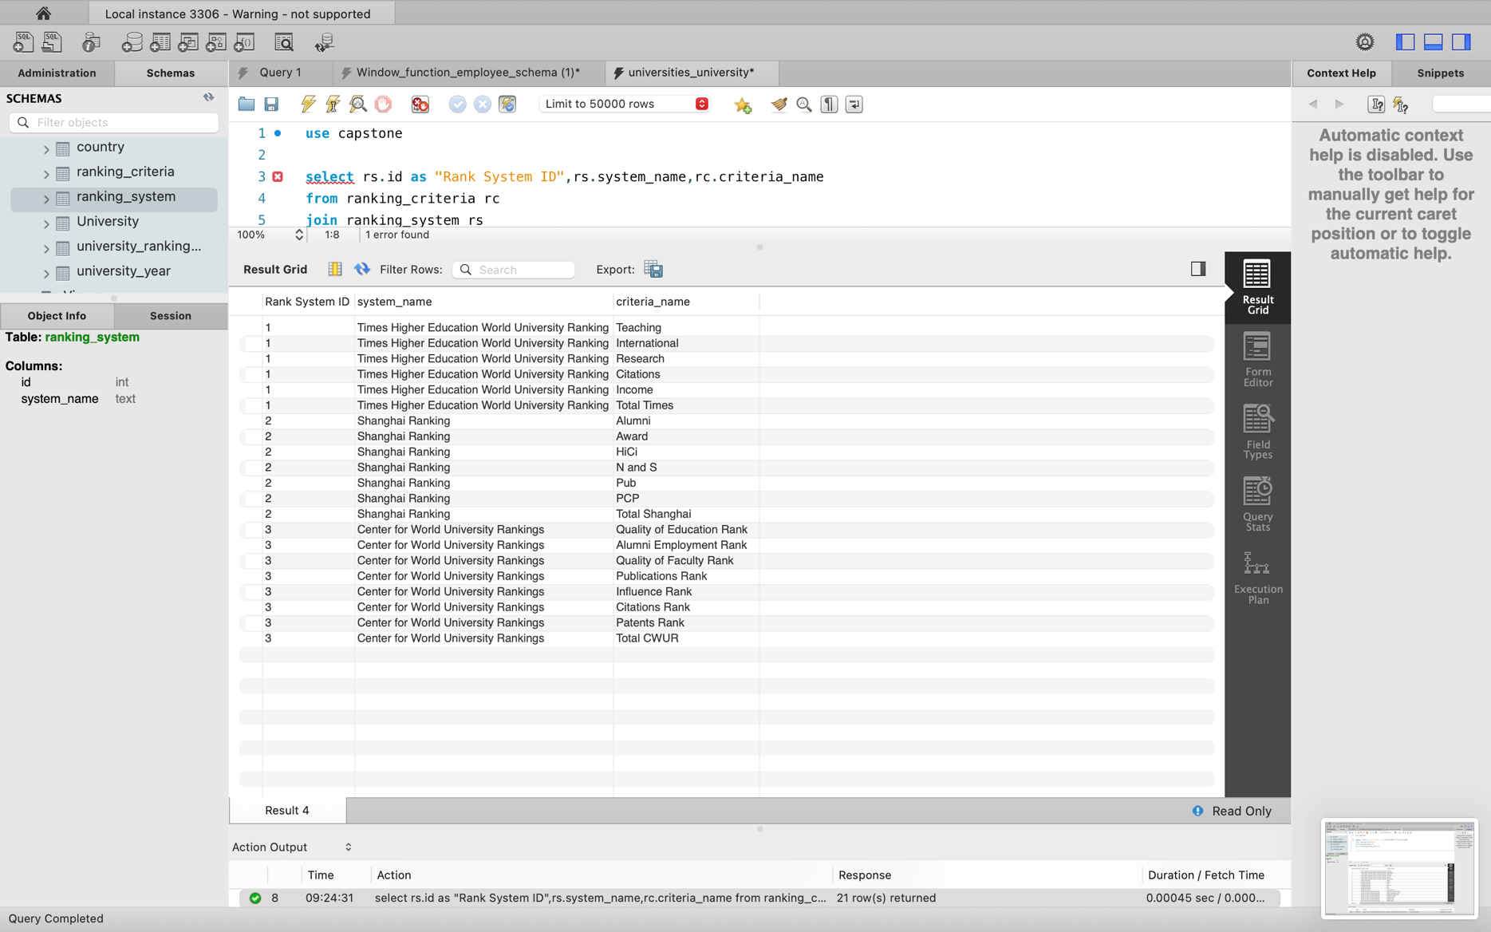
Are there any common criteria used by different ranking systems?

Slide 8
How does the choice of ranking system affect a university's international Student's enrolment?

Slide 9
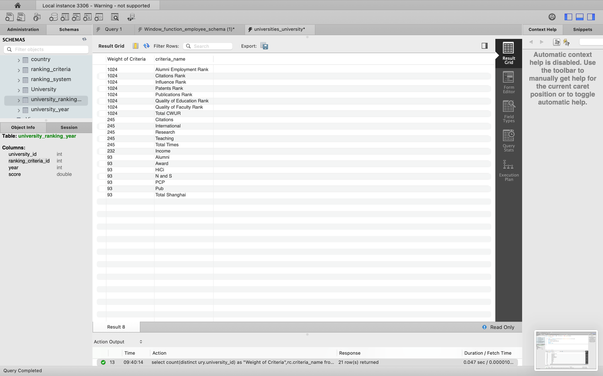
Are there any criteria that have different weights in different ranking systems?

Slide 10
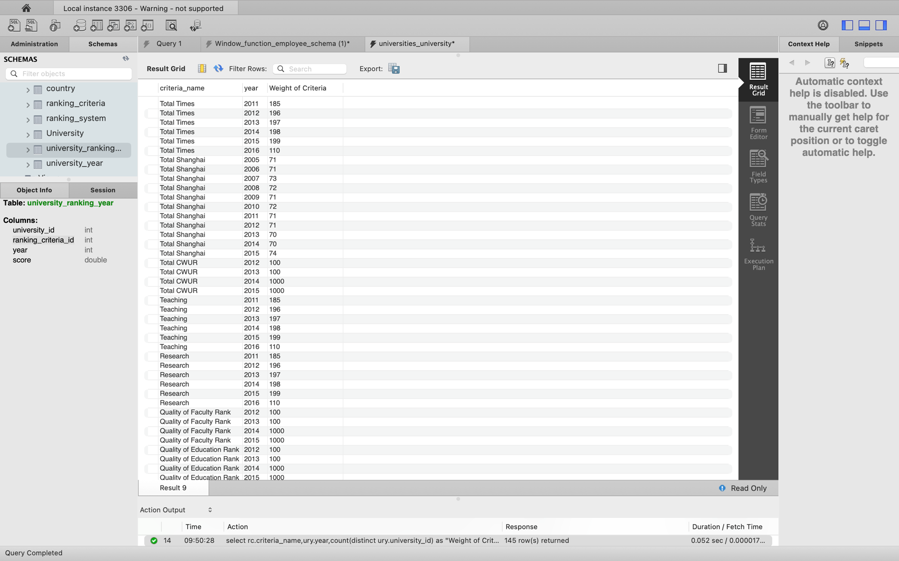
How have the weights of ranking criteria changed over time?

Slide 11
Is there a relationship between a university's score and the student-staff ratio?

Slide 12
How does the number of female students differ across universities?
Is there a relationship between a university's score and the student-staff ratio?

Slide 13
What is the distribution of universities across different countries?

Slide 14
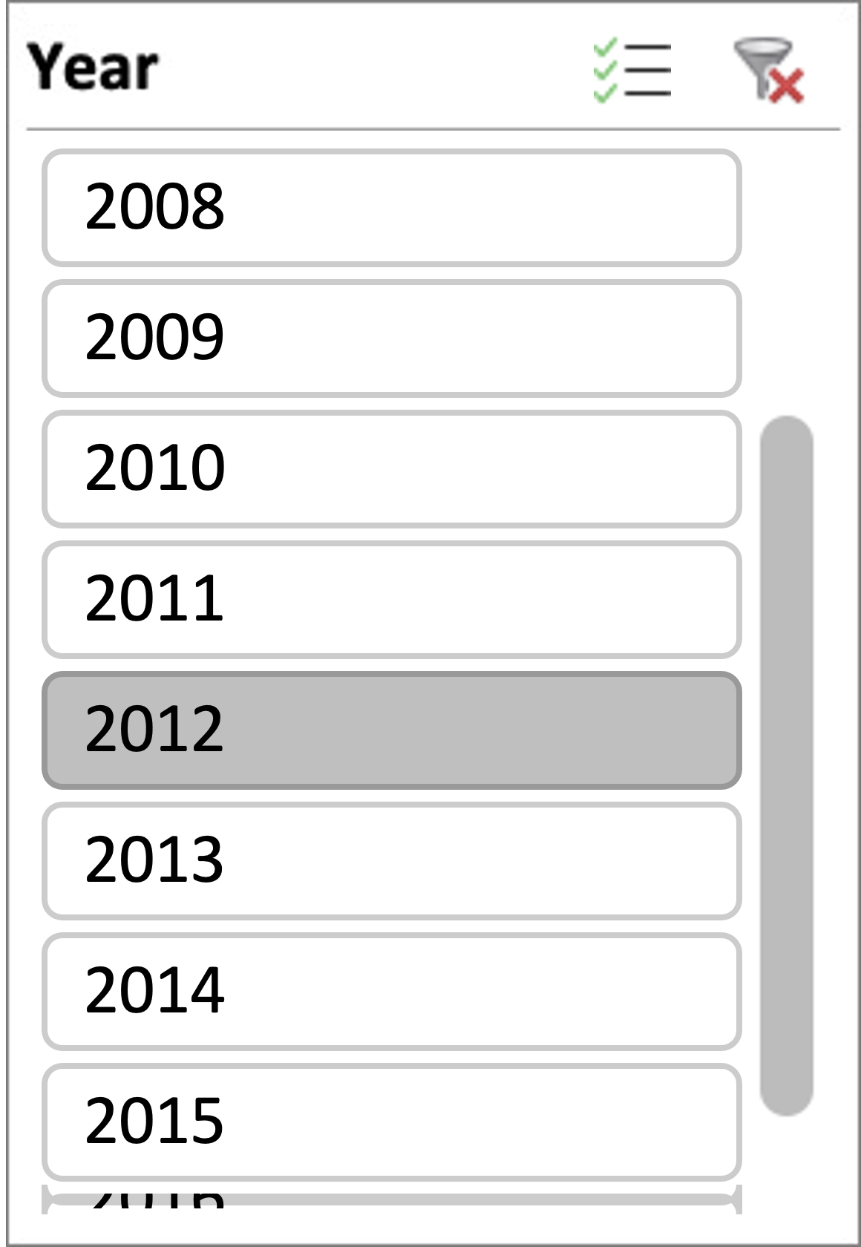
How has the ranking of universities changed over years?
University Name | Score | Year | Rank
Harvard University | 1287 | 2012 | 1
University of Zurich | 1261 | 2012 | 2
Princeton University | 1255 | 2012 | 3
Karolinska Institute | 1247 | 2012 | 4
Utrecht University | 1234 | 2012 | 5
University of Sydney | 1233 | 2012 | 6
University of California, Santa Barbara | 1228 | 2012 | 7
University of British Columbia | 1220 | 2012 | 8
California Institute of Technology | 1213 | 2012 | 9
University of Cambridge | 1206 | 2012 | 10
University of Bristol | 1203 | 2012 | 11
Carnegie Mellon University | 1202 | 2012 | 12
University of Nottingham | 1191 | 2012 | 13
University of Copenhagen | 1183 | 2012 | 14
Leiden University | 1178 | 2012 | 15
University College London | 1159 | 2012 | 16
University of California, Berkeley | 1147 | 2012 | 17
University of Oslo | 1146 | 2012 | 18
University of Toronto | 1138 | 2012 | 19
University of Geneva | 1131 | 2012 | 20
Stanford University | 1126 | 2012 | 21
University of Chicago | 1119 | 2012 | 22
University of Oxford | 1112 | 2012 | 23
McGill University | 1107 | 2012 | 24
Brown University | 1101 | 2012 | 25
University of Helsinki | 1083 | 2012 | 26
Vanderbilt University | 1075 | 2012 | 27
Rice University | 1070 | 2012 | 28
Boston University | 1069 | 2012 | 29
Yale University | 1060 | 2012 | 30
University of Southern California | 1060 | 2012 | 30
Georgia Institute of Technology | 1054 | 2012 | 31
Northwestern University | 1049 | 2012 | 32
University of Maryland, College Park | 1045 | 2012 | 33
University of California, Davis | 1036 | 2012 | 34
University of California, Irvine | 1035 | 2012 | 35
Case Western Reserve University | 1032 | 2012 | 36
New York University | 1025 | 2012 | 37
University of Arizona | 1011 | 2012 | 38
Columbia University | 1001 | 2012 | 39
University of Rochester | 1000 | 2012 | 40

Slide 15
What is the trend in percentage of female students over time?

Slide 16
How has the ranking scores of universities evolved over years?
University Name | Score | Year | Rank
Henan Normal University | 4829 | 2015 | 1
University of Pau and Pays de l'Adour | 4788 | 2015 | 2
Yuan Ze University | 4786 | 2015 | 3
Dokuz EylÃ¼l University | 4767 | 2015 | 4
University of Thessaly | 4738 | 2015 | 5
Hunan Normal University | 4719 | 2015 | 6
University of Hyderabad | 4668 | 2015 | 7
Mansoura University | 4668 | 2015 | 8
University of Chemistry and Technology, Prague | 4645 | 2015 | 9
Shanghai Normal University | 4644 | 2015 | 10
University Name | Score | Year | Rank
California Institute of Technology | 551 | 2016 | 1
Massachusetts Institute of Technology | 549 | 2016 | 2
University of Oxford | 545 | 2016 | 3
ETH Zurich â€“ Swiss Federal Institute of Technology Zurich | 529 | 2016 | 4
Johns Hopkins University | 524 | 2016 | 5
University of Cambridge | 522 | 2016 | 6
Stanford University | 521 | 2016 | 7
Imperial College London | 507 | 2016 | 8
Harvard University | 497 | 2016 | 9
Princeton University | 496 | 2016 | 10

Slide 17
How has the ranking scores of universities evolved over years?
University Name | Score | Year | Rank
University of Pau and Pays de l\ Adour | 4599 | 2014 | 1
University of AlmerÃ­a | 4549 | 2014 | 2
Shaanxi Normal University | 4545 | 2014 | 3
Tamkang University | 4527 | 2014 | 4
Federal University of Santa Maria | 4519 | 2014 | 5
Shanghai Normal University | 4516 | 2014 | 6
Fu Jen Catholic University | 4493 | 2014 | 7
Yuan Ze University | 4492 | 2014 | 8
University of Chemistry and Technology | 4489 | 2014 | 9
I-Shou University | 4489 | 2014 | 10
University Name | Score | Year | Rank
Harvard University | 1171 | 2011 | 1
California Institute of Technology | 986 | 2011 | 2
University of Cambridge | 983 | 2011 | 3
Stanford University | 952 | 2011 | 4
University of Oxford | 898 | 2011 | 5
University of California | 893 | 2011 | 6
Princeton University | 868 | 2011 | 7
Columbia University | 817 | 2011 | 8
University of Chicago | 803 | 2011 | 9
Yale University | 788 | 2011 | 10

Slide 18
How has the ranking scores of universities evolved over years?
University Name | Score | Year | Rank
University of California | 1300 | 2013 | 1
California Institute of Technology | 1284 | 2013 | 2
Harvard University | 1276 | 2013 | 3
Princeton University | 1263 | 2013 | 4
Carnegie Mellon University | 1241 | 2013 | 5
University of Sydney | 1234 | 2013 | 6
Karolinska Institute | 1209 | 2013 | 7
University of British Columbia | 1203 | 2013 | 8
University of Cambridge | 1175 | 2013 | 9
Utrecht University | 1171 | 2013 | 10
University Name | Score | Year | Rank
Harvard University | 1287 | 2012 | 1
University of Zurich | 1261 | 2012 | 2
Princeton University | 1255 | 2012 | 3
Karolinska Institute | 1247 | 2012 | 4
Utrecht University | 1234 | 2012 | 5
University of Sydney | 1233 | 2012 | 6
University of California | 1228 | 2012 | 7
University of British Columbia | 1220 | 2012 | 8
California Institute of Technology | 1213 | 2012 | 9
University of Cambridge | 1206 | 2012 | 10

Slide 19
Is there a relationship between universities ranking score and the number of students over time?

Slide 20
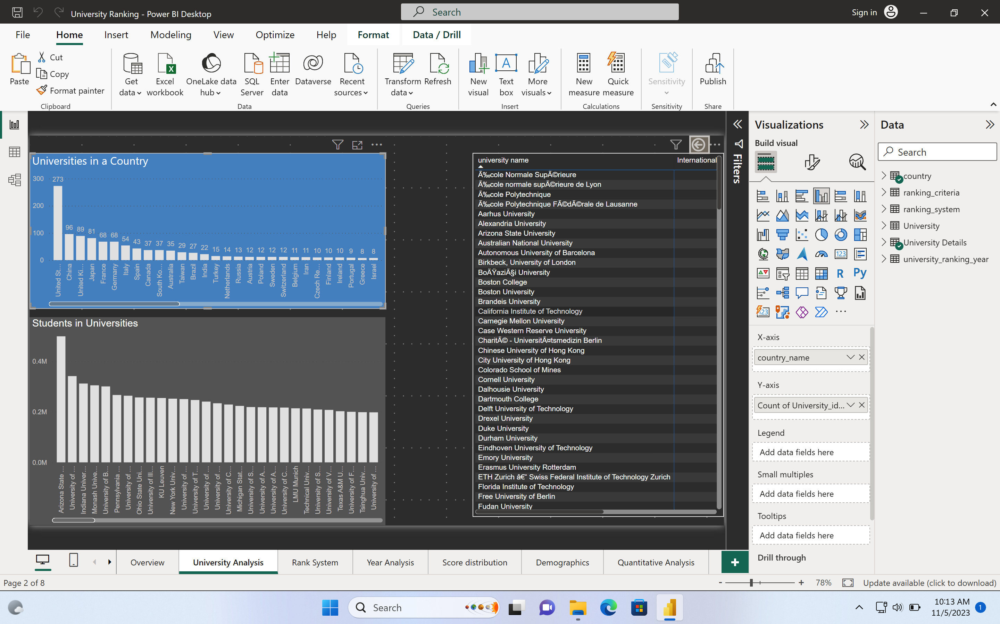
How many universities are there in each country?

Slide 21
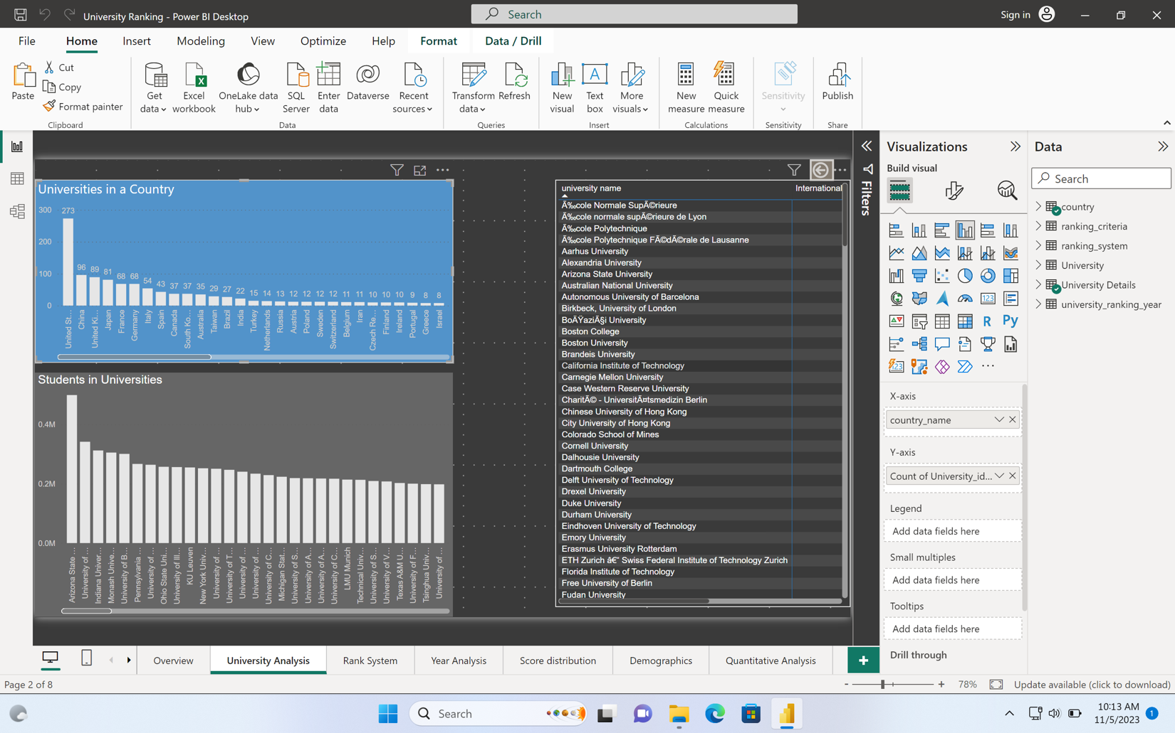
Which university has highest number of students?

Slide 22
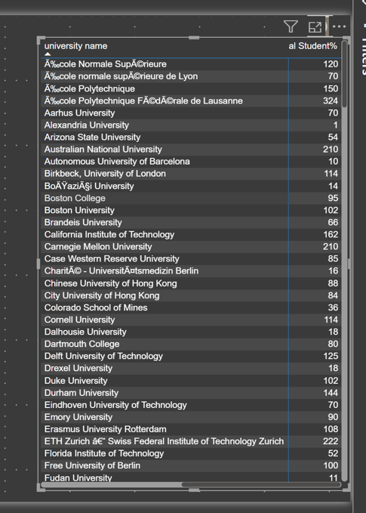
How does the percentage of international students vary across universities?

Slide 23
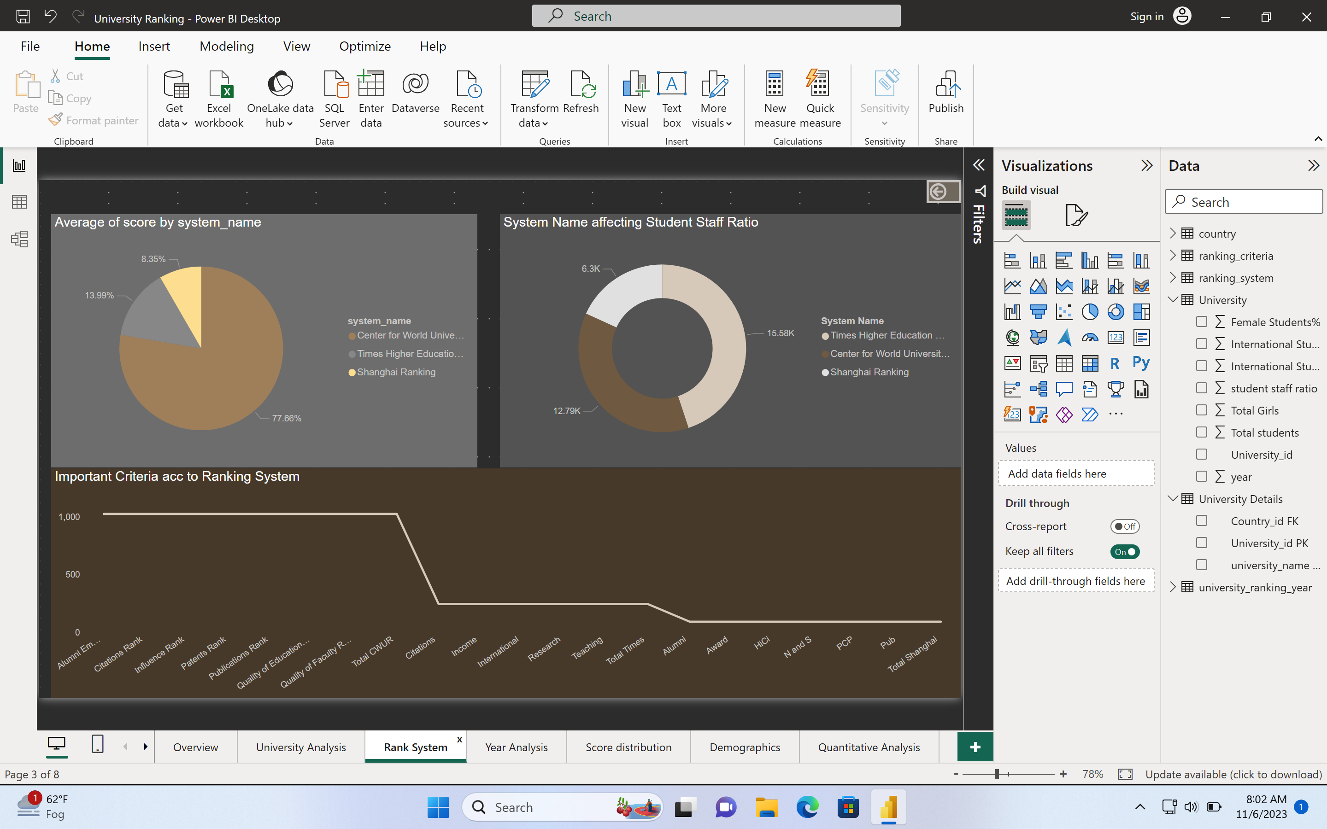
What is the average score for universities according to each ranking system?

Slide 24
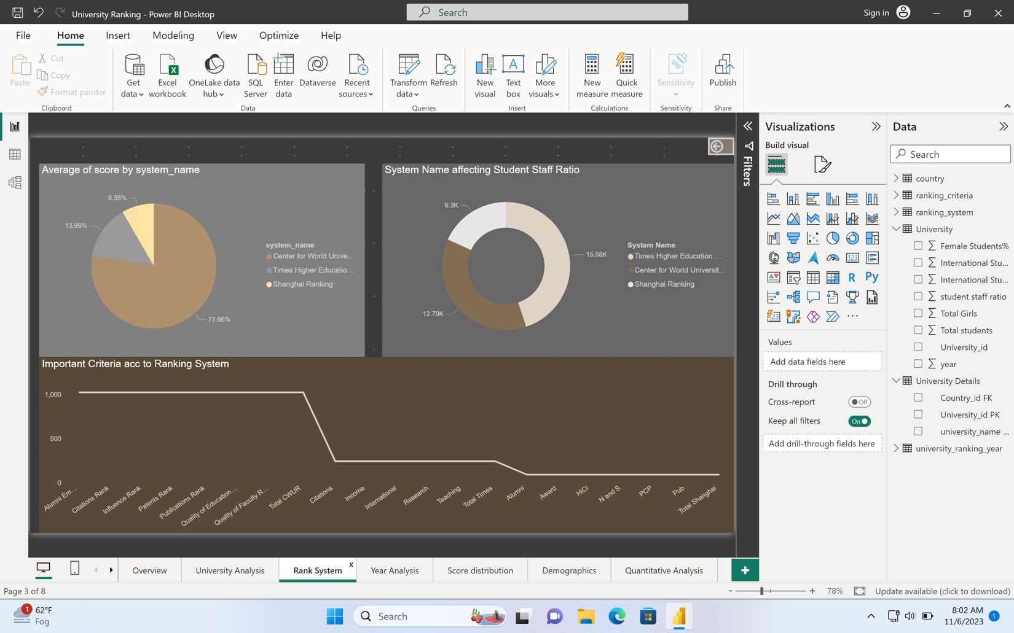
How does the ranking system affect student staff ratio?

Slide 25
What are the most important criteria considered by ranking system?

Slide 26
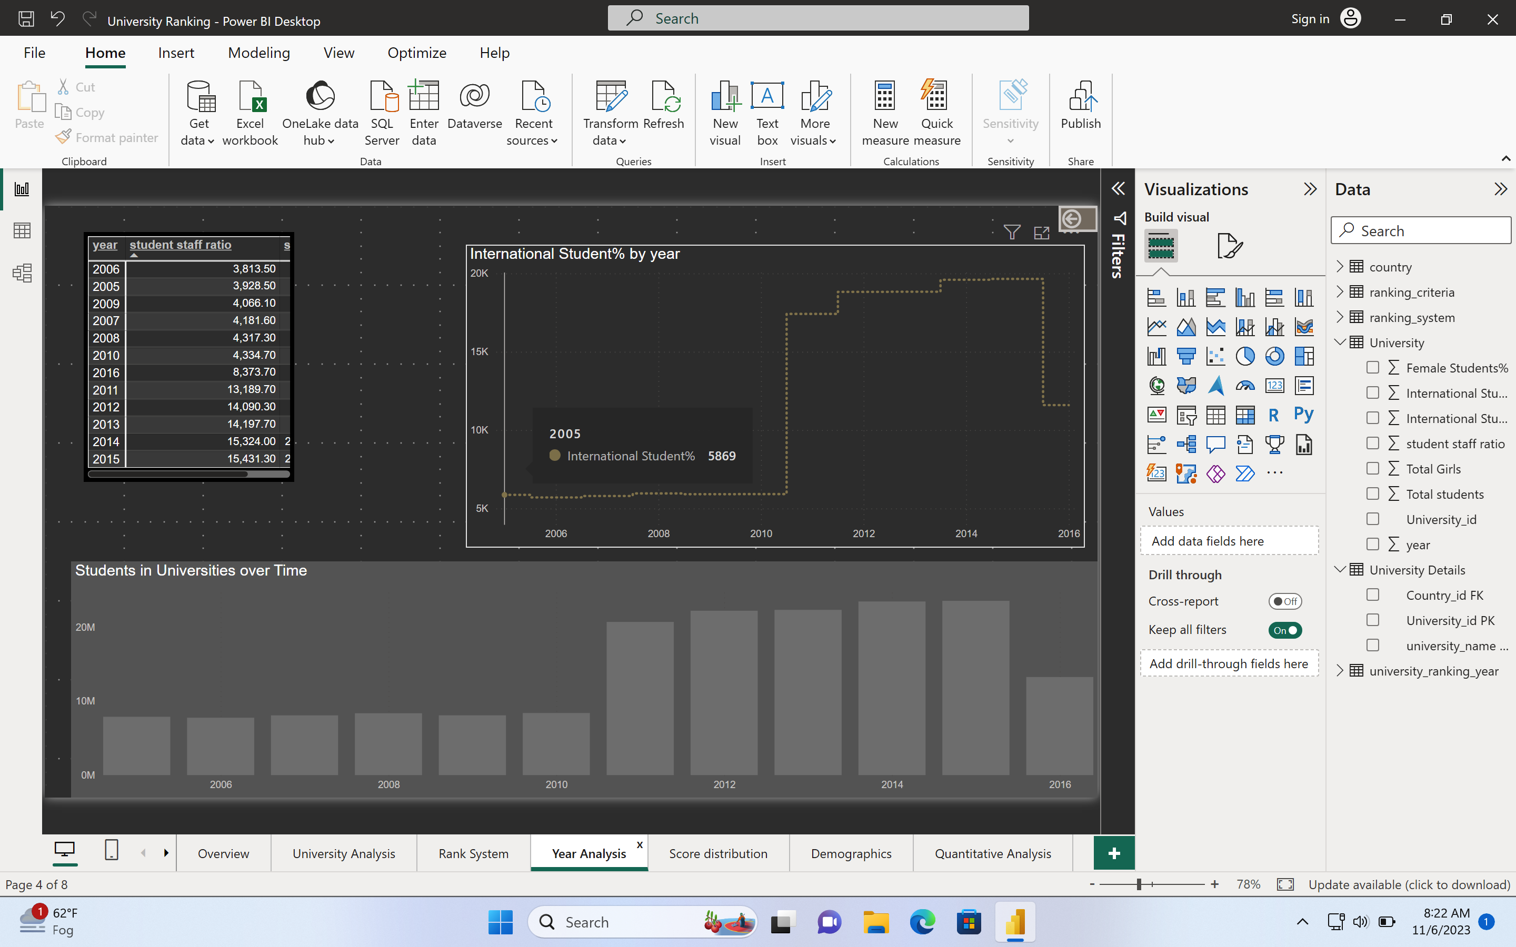
How does the number of students change in universities over time?

Slide 27
Is there a correlation between university’s ranking score and student staff ratio over the years?

Slide 28
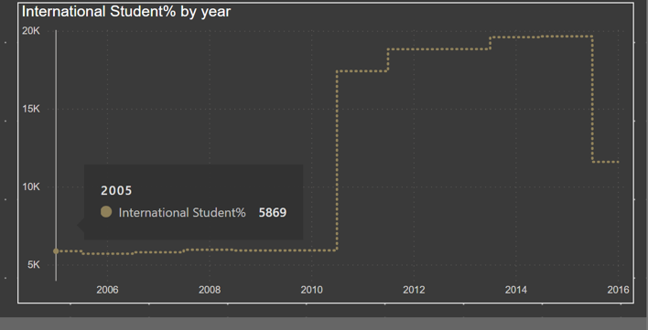
How does the percentage of international students vary across different years?

Slide 29
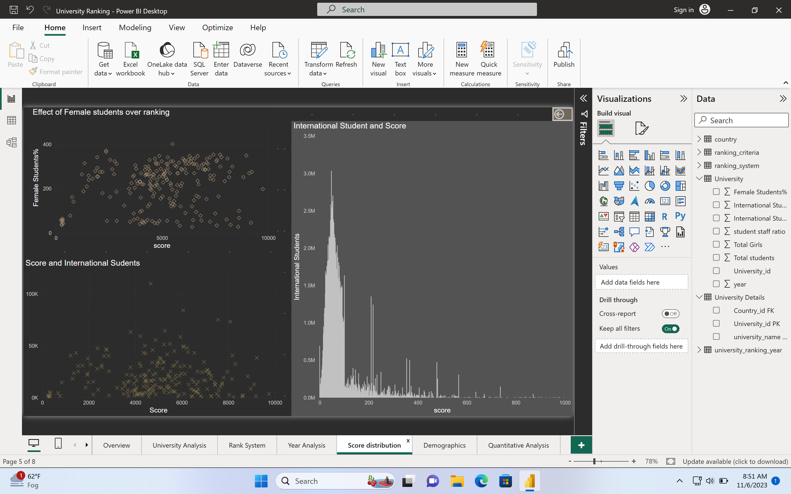
Is there a correlation between universities score and the number of international students?

Slide 30
How does the percentage of female students impacts a university ranking?

Slide 31
What is the impact of university’s ranking on the number of international students it attracts?

Slide 32
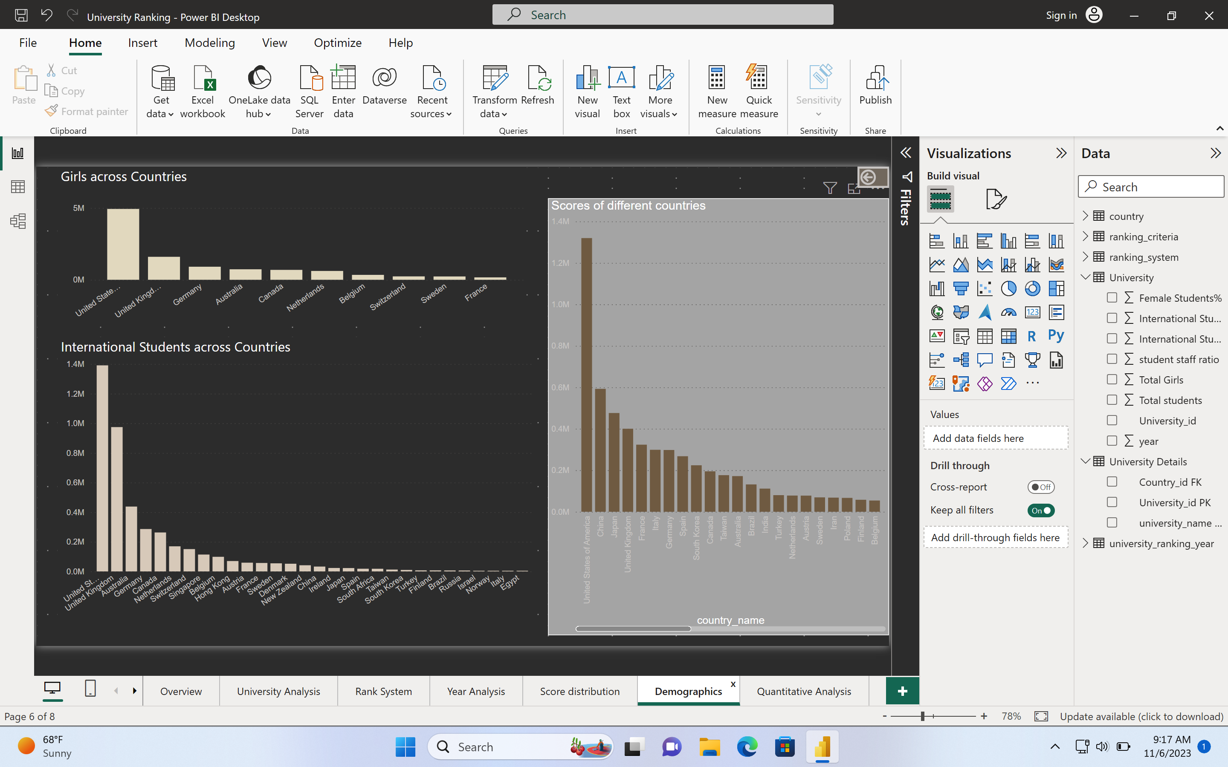
What is the distribution of international students across different countries?

Slide 33
Which country has the highest number of females enrolled in universities?

Slide 34
Are there any significant trends or patterns in the rankings of universities from different countries?

Slide 35
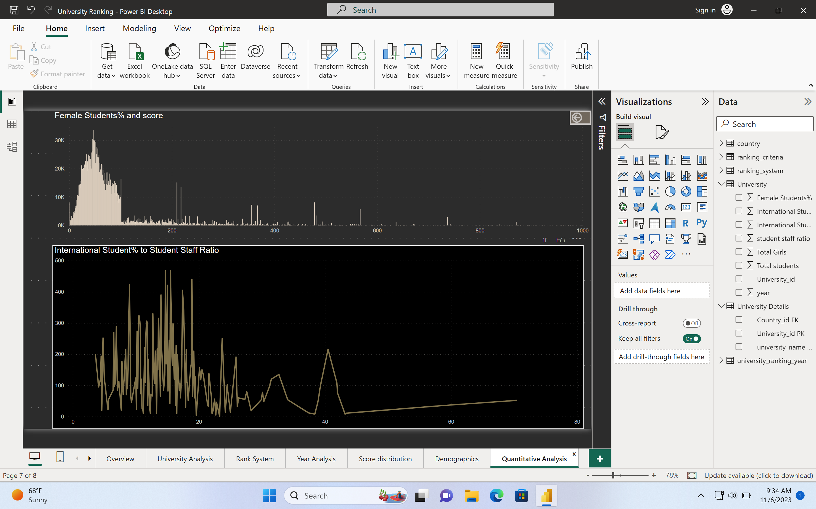
How does the percentage of international students affect a university’s student staff ratio?

Slide 36
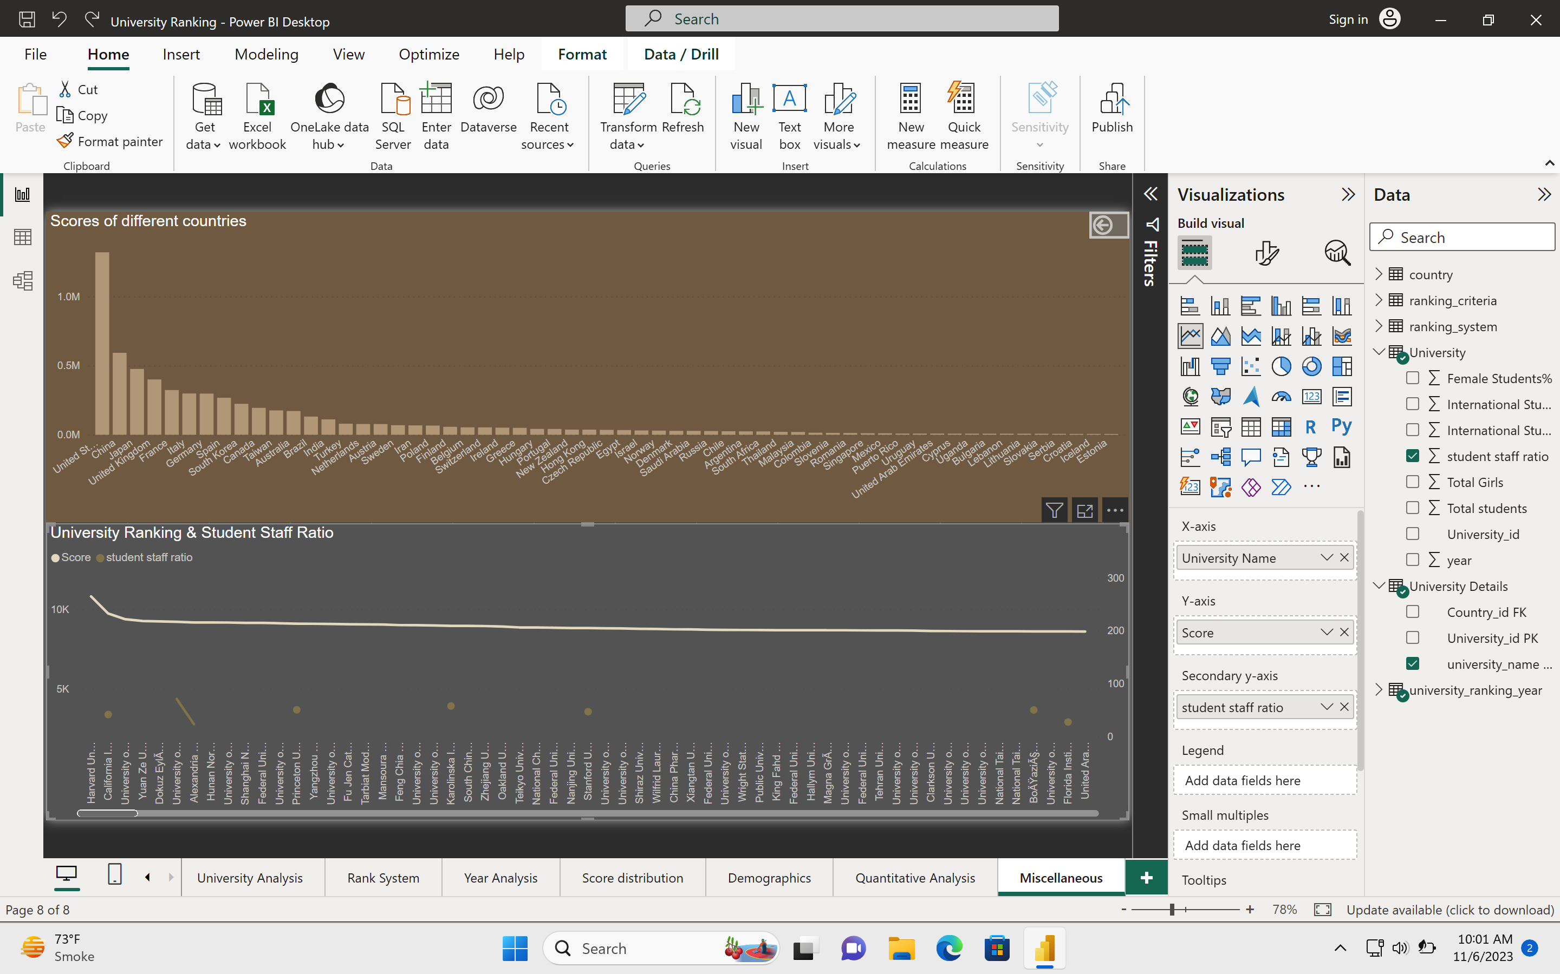
Is there a correlation between university’s ranking and student staff ratio?

Slide 37
Conclusion
This analysis was undertaken with the objective of conducting a comprehensive examination of university rankings.
Our primary goals were to compare university standings across diverse ranking systems, evaluate the effects of ranking criteria on university positions, and delve into the dynamic changes in university metrics over time. Another noteworthy observation was the evolutionary journey of universities over time.
The number of universities that secured rankings and their performance exhibited a dynamic narrative. Some universities upheld steadfast and consistent rankings, whereas others experienced ebbs and flows in their standings, resulting in a landscape of academic dynamism.

